Slide 1
Effort, Mastery, and Mathematics in Decision Making
Sherod Brooks, Natalee Cooper, and Cole Mortemore
Faculty Advisor: Professor David Stuckey
McMaster Symposium Wednesday, April 26, 2023

Slide 2
Abstract
Based on conversations with professor Tim Green and data supplied by him, we are trying to find the best way to assign grades based on mastery and effort. How should individual assignments be weighted for these two concepts? We use the methods of linear programming and the Excel program to determine a reasonable ratio between mastery and effort. Other applications for these ideas will be considered.

Slide 3
The Interview
Professor Green expressed his main concerns
Grades based on mastery vs effort
Desired mathematical fairness
English 109 Writing Workshop
Assignments in the class
Class syllabus breakdown
Ratios (ex. brainstorm : more effort than mastery)
The easiest way for him to work a spreadsheet

Slide 4
Spreadsheet Layout and Organization

Slide 5
User Friendly
Goal: Make the spreadsheet accessible to anyone
Integers/Decimals in the worksheet
Simplified process for entering grades
Easy to make adjustments
Format of the spreadsheet makes it is easy to follow
Formulas

Slide 6
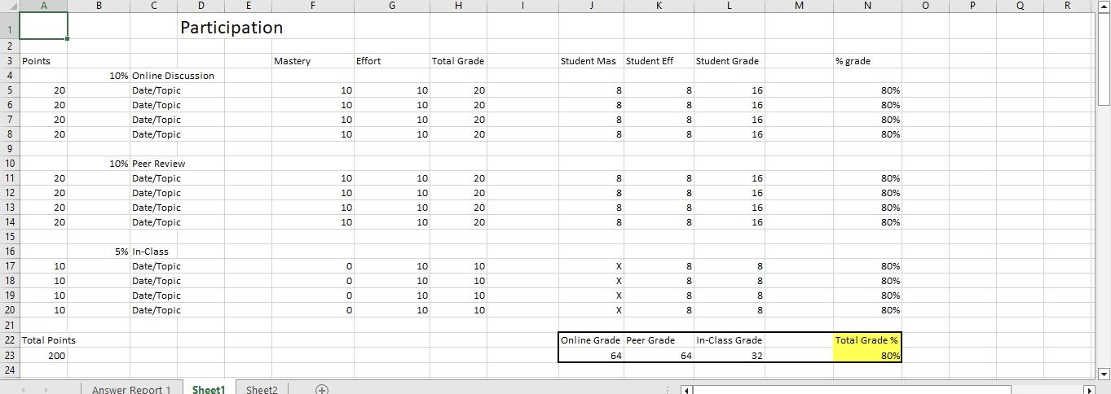
User Friendly cont.

Slide 7
Constraints
Define what a Constraint is
Major constraints - integers/decimals, can not be negative, student variable
How the assignments are weighted
Emphasis on the mastery and effort

Slide 8
Solver Program
What is Solver
Description of solver
What is solver used for/ how we used solver
Where is solver in Excel and how to download it
How to use solver
Limitations of solver
Tools comparable to solver

Slide 9
Debugging/Streamlining
Issues with finding the solution
Had to restart with solver
Making sure every formula is in the correct spots and has the correct cells
Could not have the essay constraints as integers in solver
Added chain addition
For the final answer, we also controlled how many decimal places were shown to allow for simpler solutions

Slide 10
Final Results

Slide 11
Other Applications
Sports
Ability vs Effort
Workplace
Laber vs Customer Interaction
Construction Jobs
Time of a Job vs Materials needed
Military
Physical Ability vs Mental Dexterity
And more…

Slide 12
Topics For Further Study
How should overall student growth in a semester affect their final grades?
Including actual student data at various levels of achievement
Preferred organization (ex. total points possible in mastery and effort)
Adding attendance into the final grade
Extra credit

Slide 13
Questions
Thank you Dr. Brown for input on organization of the spreadsheet.

